Slide 1
Radiometric Preprocessing: Atmospheric Correction

Slide 2
“Correction” for Sun Angle Differences
Radiometric Preprocessing
θ is the solar zenith angle and varies as a function of latitude, day of year, and time of day
Radiance is proportional to cos θ. Therefore, we can adjust for sun angle effects by:
adjusted DN = (cos θ’ / cos θ) x DN
where θ = input sun angle and θ’ is the normalized or reference angle (e.g., 45 degrees or θ for one of several dates of imagery
θ
Sun
Ground

Slide 3
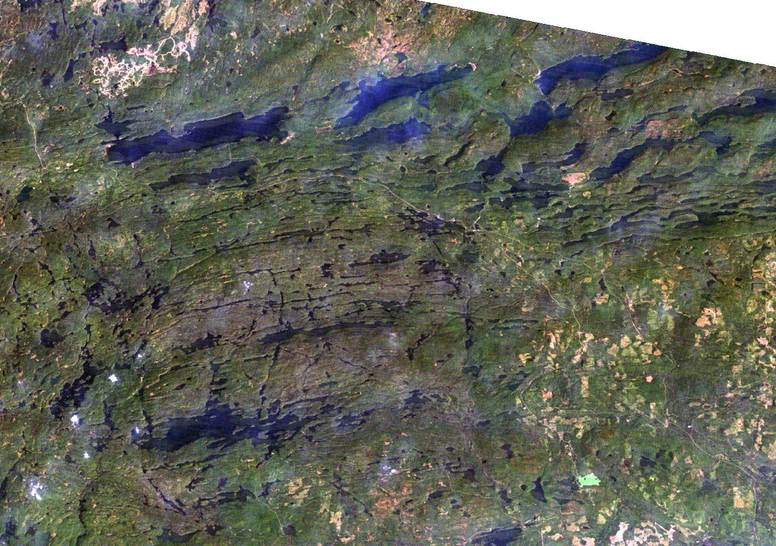
Haze over northeast Minnesota

Slide 4
Effects of atmospheric scattering and absorption on spectral-radiometric responses
Effects of scattering on image quality
Reduces contrast – dark objects are brighter, bright objects are darker
Visible bands are much more subject to atmospheric effects than infrared bands
Sensitivity of spectral bands (high to low) to atmospheric effects
blue, green, red, near IR, middle IR

Slide 5
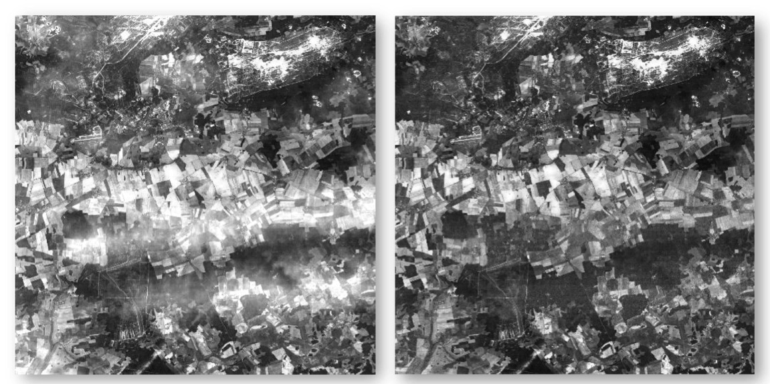
Methods for Atmospheric Correction
Atmospheric (radiative transfer) models
Most rigorous, best, but complex
Difficult to obtain necessary input data
Example of atmospheric correction with the ATCOR model
Before
After
Jensen, 2007

Slide 6
Histogram adjustment
Shifts histograms to left (to zero) under the assumption that very dark objects (0% reflectance) would be at zero if it were not for the added response due to atmospheric scattering
i.e., the path radiance term in the remote sensing equation
Assumes the magnitude of scattering is the same for all cover types (not exactly correct)
Does not correct for atmospheric absorption effects

Slide 7
Histogram Adjustment (Dark Object Subtraction)
Find pixels of dark objects that are assumed to have near zero reflectance
Deep, clear lakes are good
Subtract their DN value from all pixels (e.g., 30)
Has the effect of shifting the histogram to start at 0
Shift attributed to haze
Number of Pixels
0
30
255
Digital Number

Slide 8
Histogram Adjustment (Dark Object Subtraction)
Find pixels of dark objects that are assumed to have near zero reflectance
Deep, clear lakes are good
Subtract their DN value from all pixels (e.g., 30)
Has the effect of shifting the histogram to start at 0
New histogram
Number of Pixels
0
30
255
Digital Number

Slide 9
Demonstration of Image Enhancement with Image Processing Software
Spectral band combinations
Radiometric Enhancement: Contrast stretch
Spatial Enhancement: Convolution filtering
Principal Components

