Slide 1
Object-based Image Analysis
Keith C. Pelletier
FR3262/5262
October 11, 2012

Slide 2




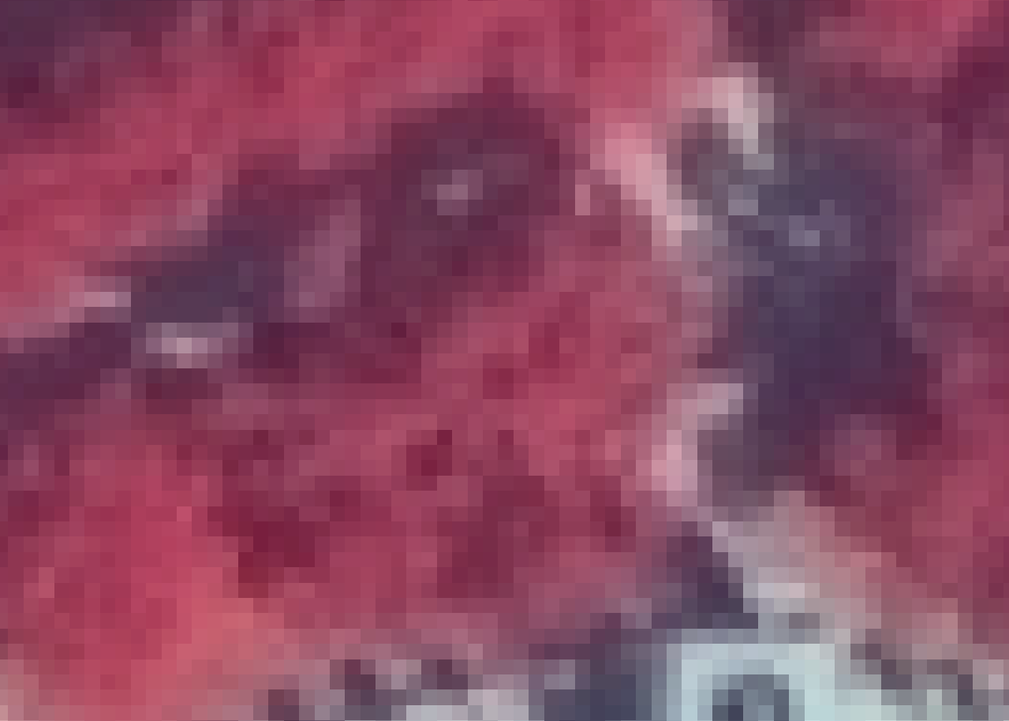
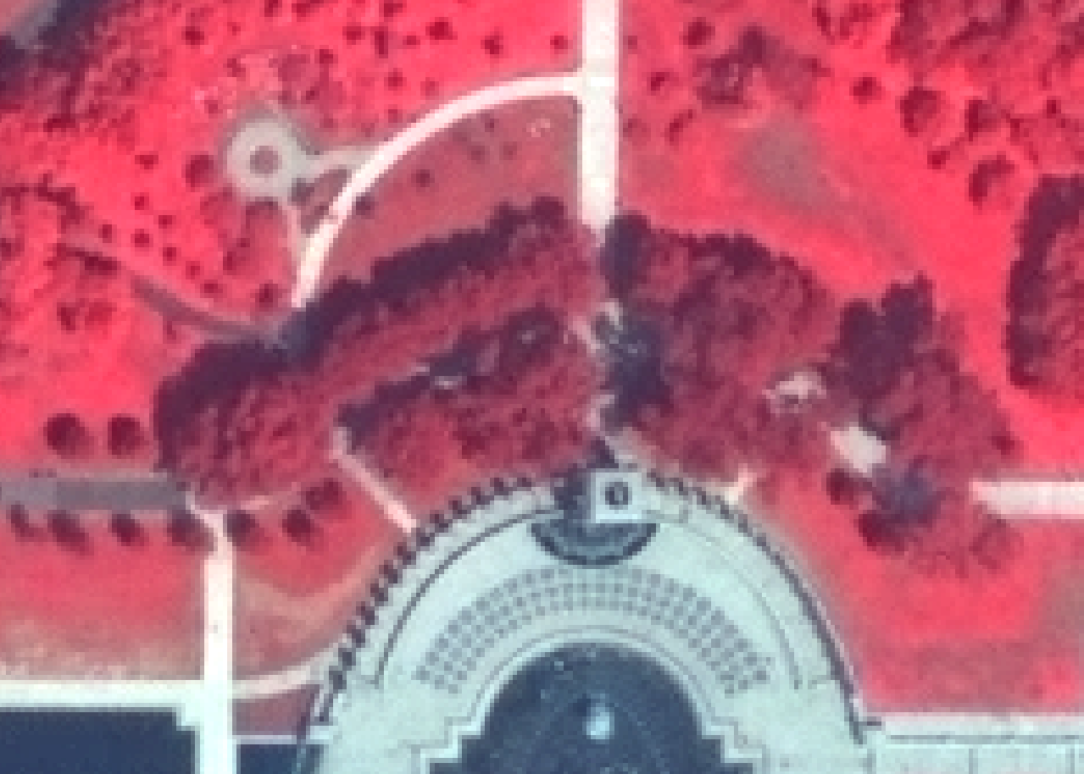
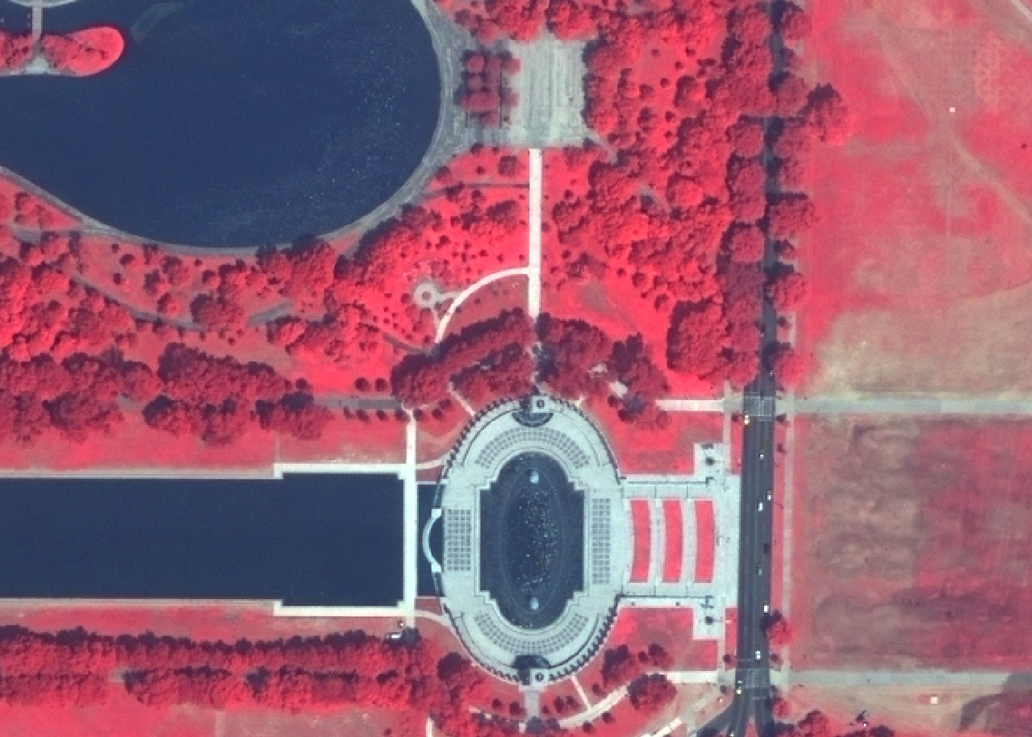

Slide 3
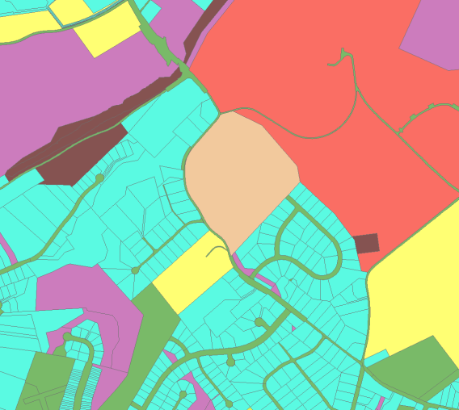
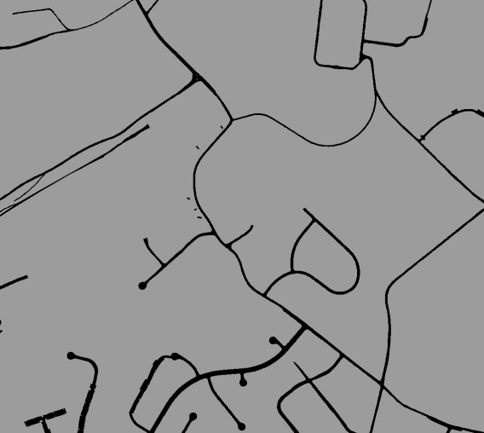


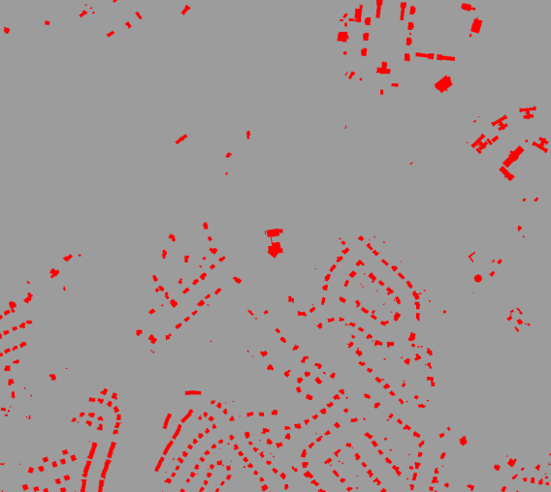
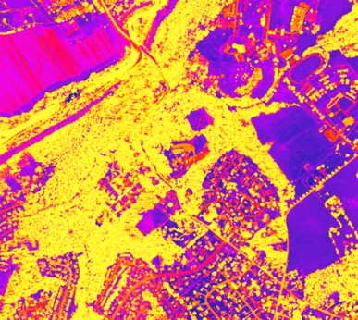
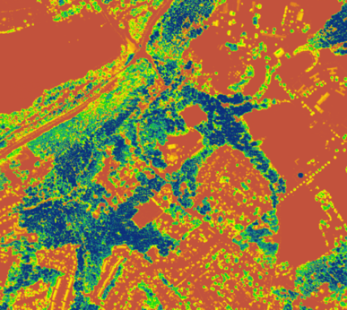
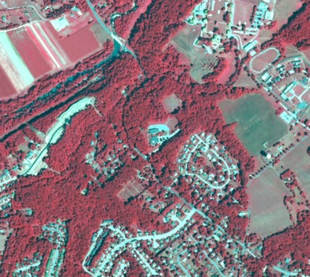
Data Inundation

Slide 4
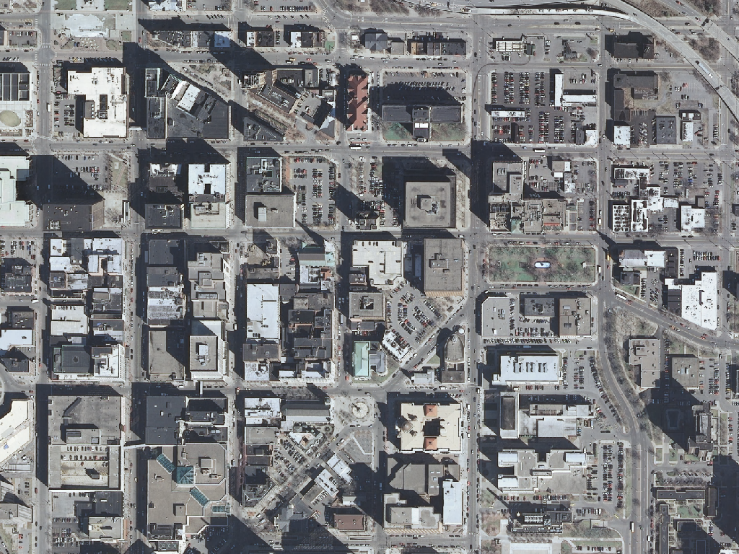

Slide 5
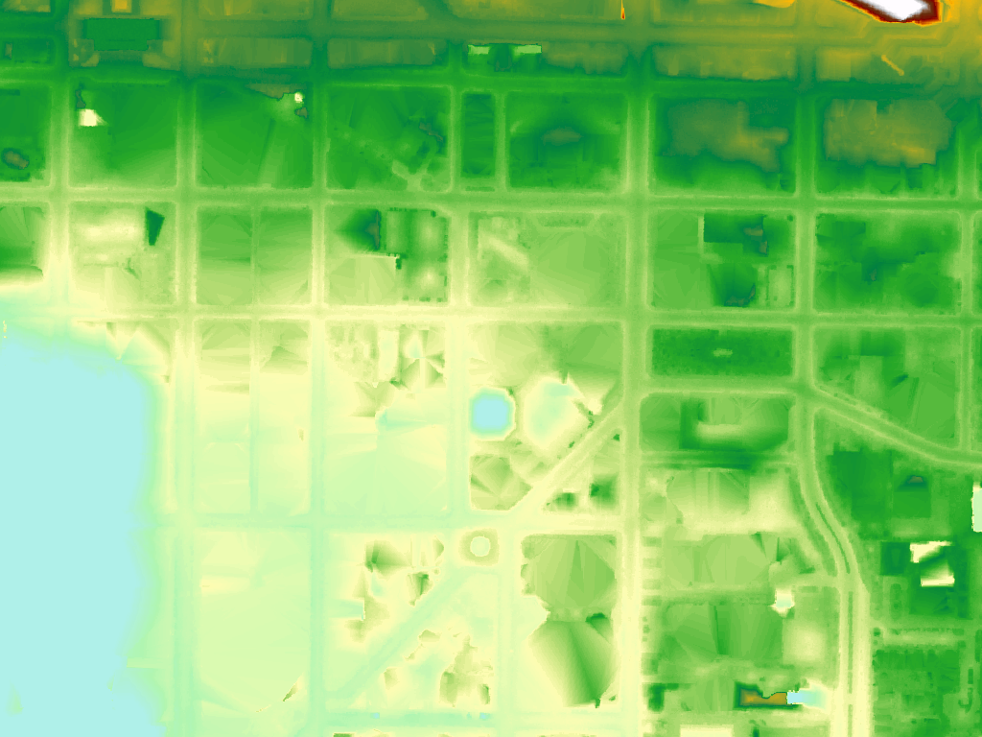

Slide 6
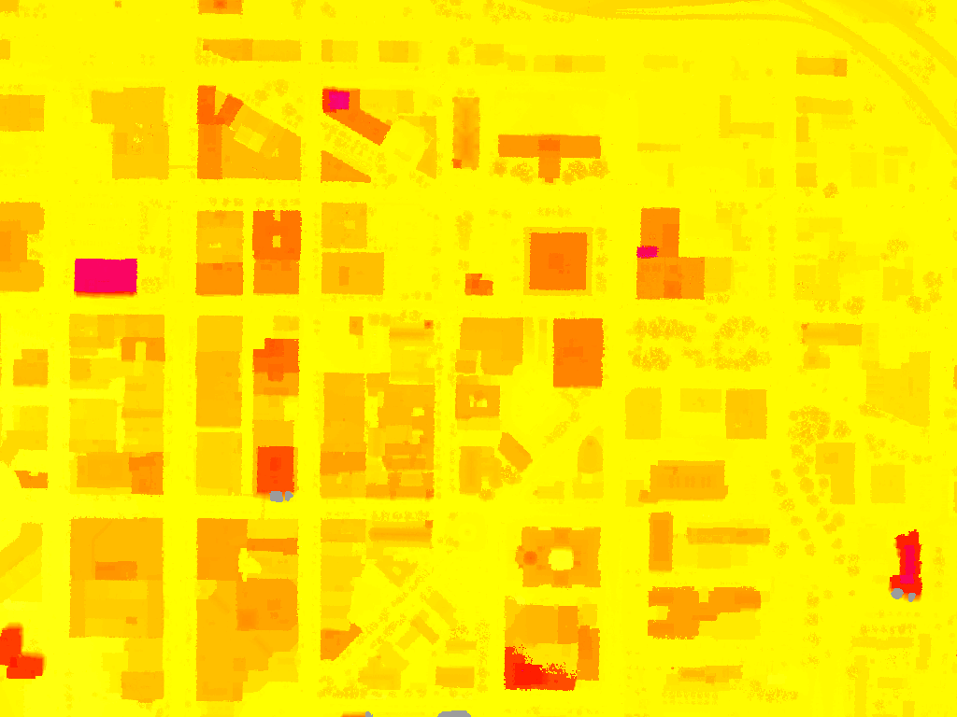

Slide 7
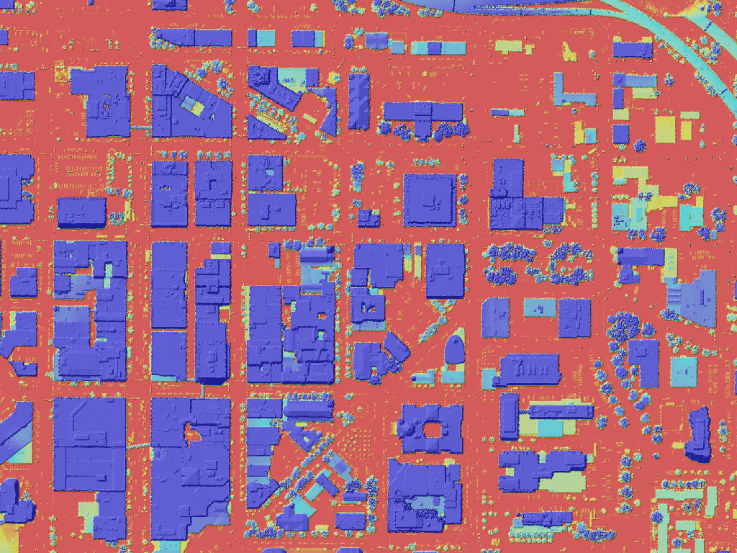

Slide 8
OBIA Systems
Requirements
Components
Replicate the human
Leverage existing data
Economic advantage
Expert Systems
Raster, Vector, & Point Cloud
Enterprise Processing

Slide 9
Objects
Homogenous Groups of Pixels
Building Blocks for OBIA Classification
Contain Information related to data layers AND other objects
Nested Hierarchy
Based on Scale, Color, and Shape*

Slide 10
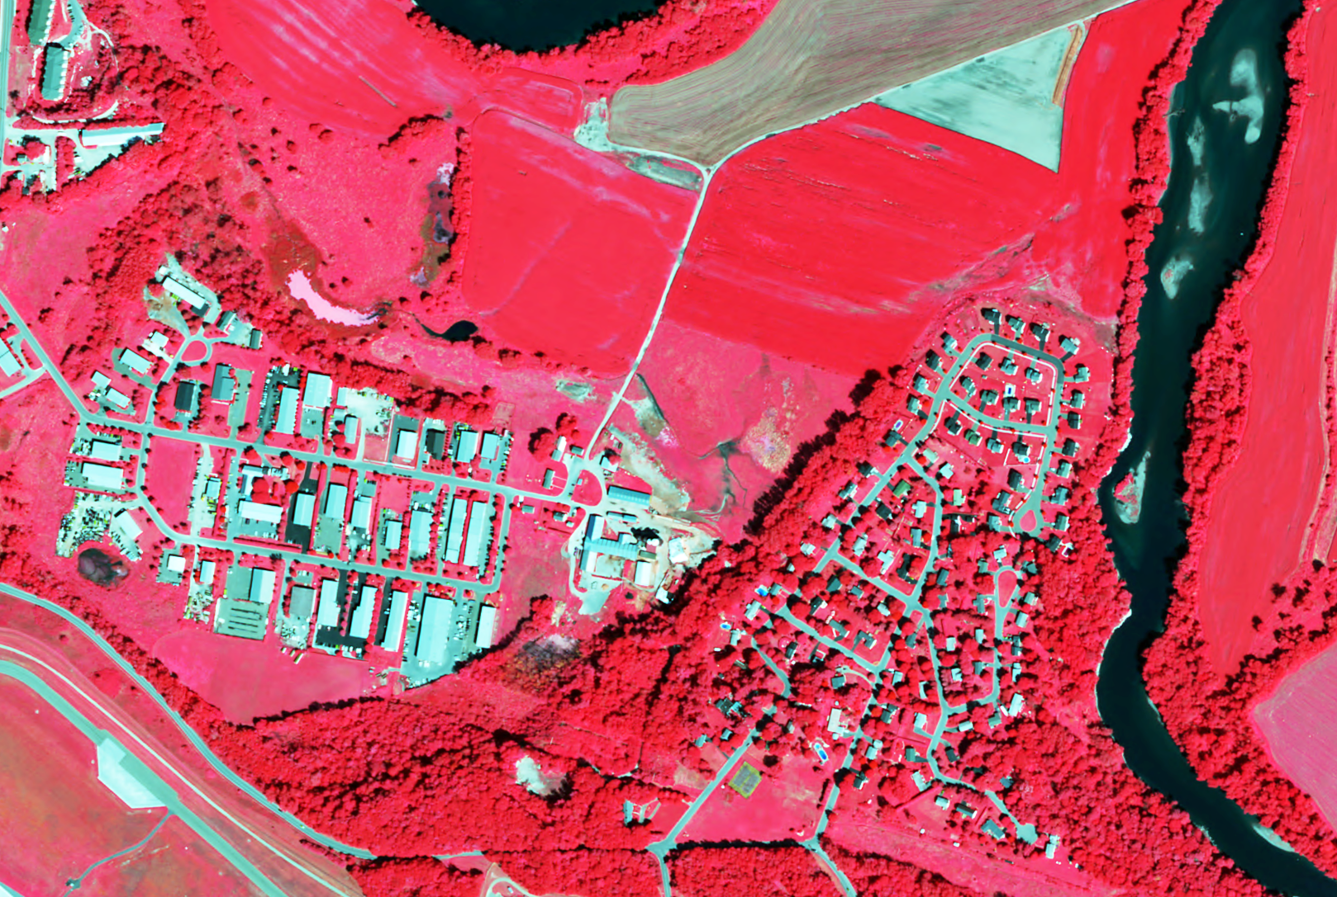

Slide 11
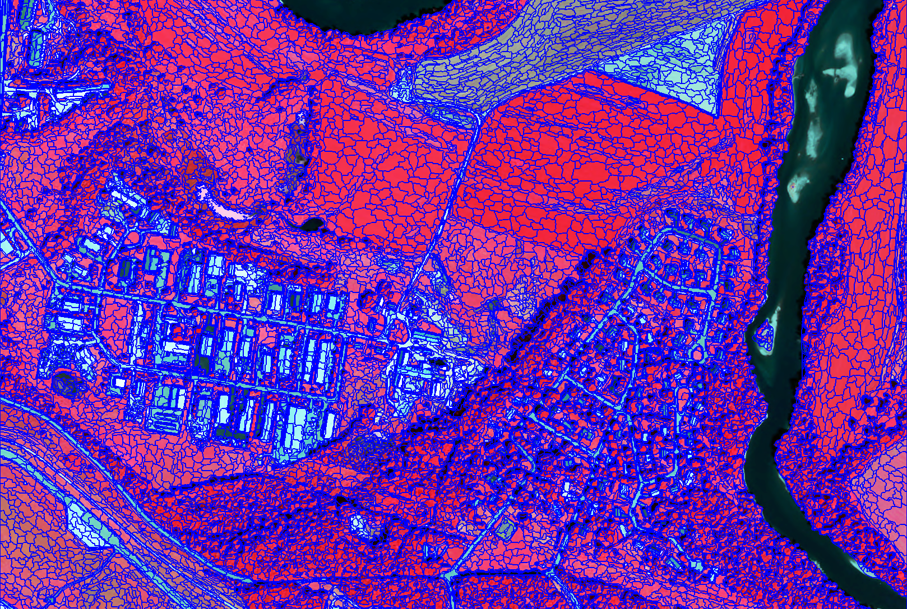

Slide 12
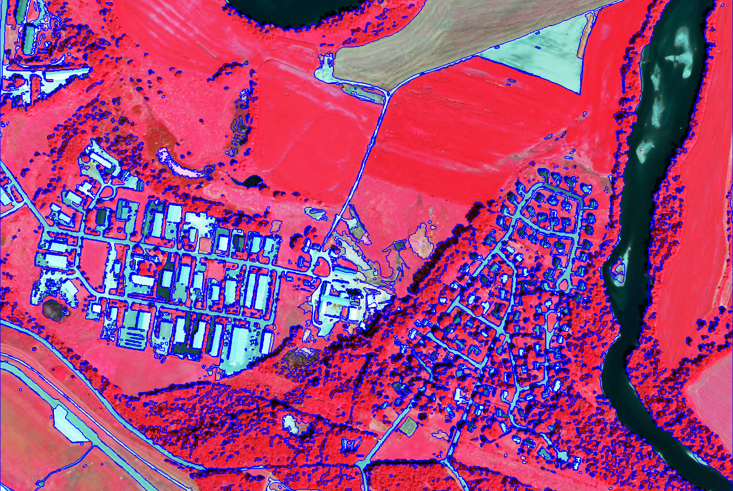

Slide 13
OBIA Approach
Segmentation
Integration
Morphology
Classification
Objects

Slide 14
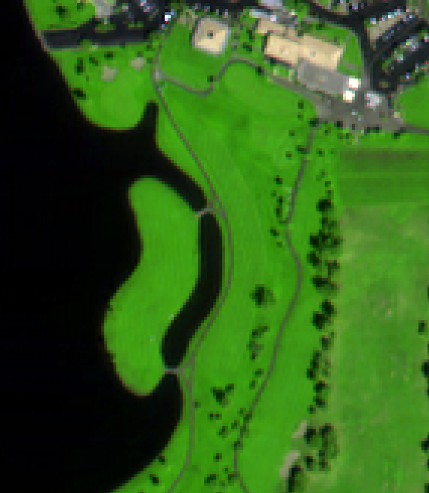
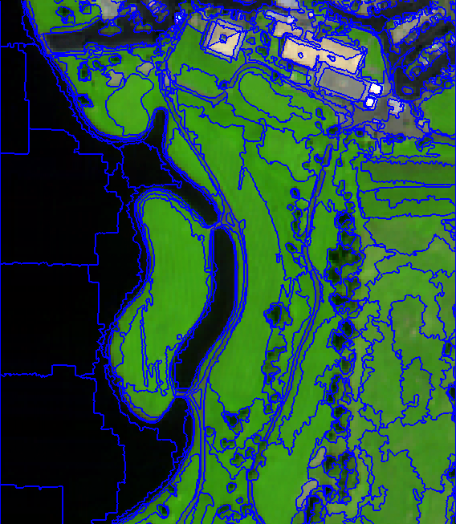
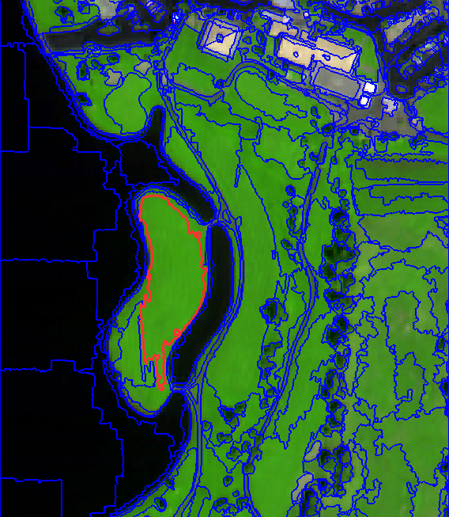
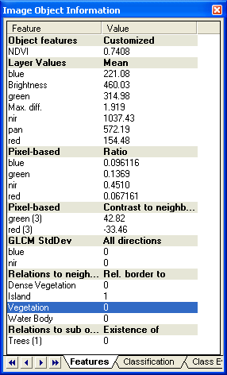
Object Information
Source: Definiens

Slide 15
Each object knows its ...
Neighbor objects
Sub-objects
Super-object

Slide 16
Tone/Color
Shape
Texture
Size
Association
Location
Pattern
Shadow
Height

Slide 18
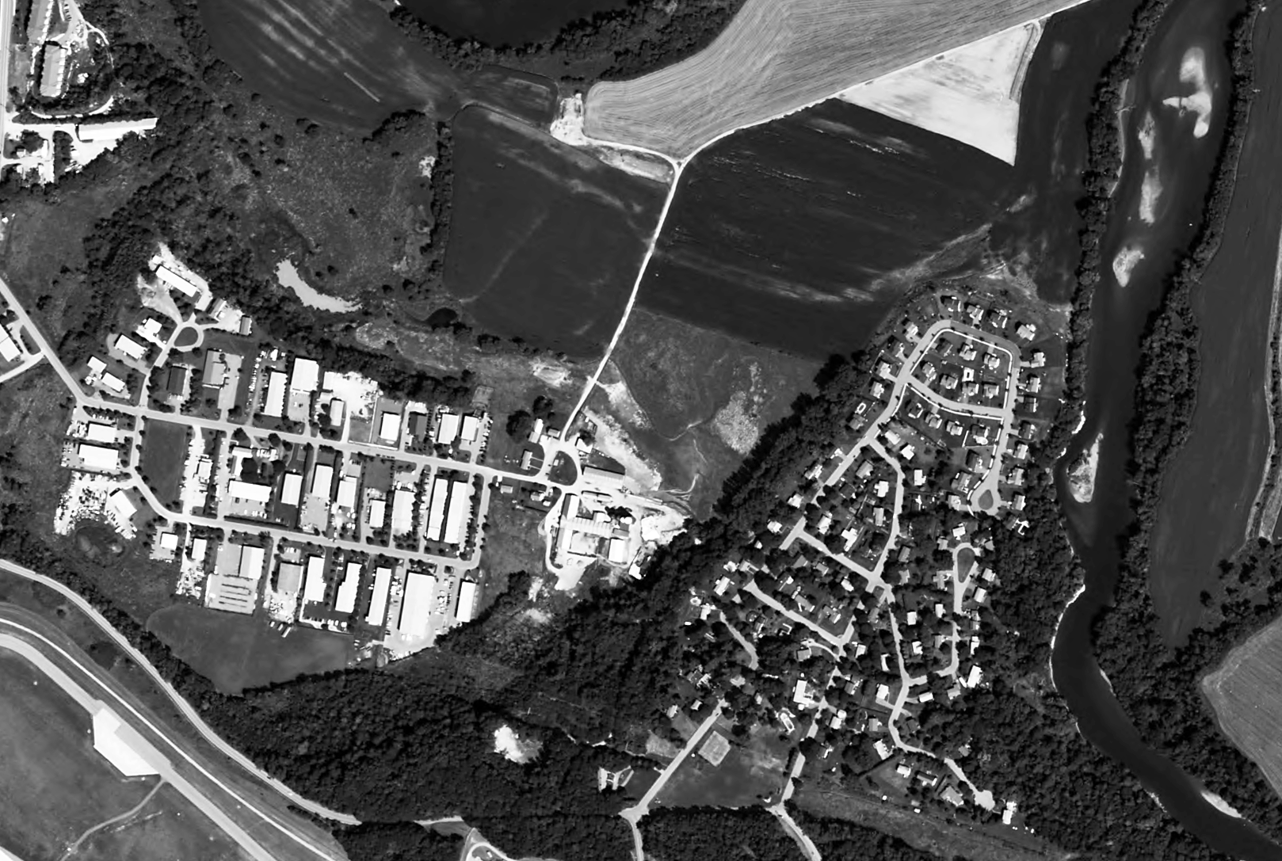

Slide 19
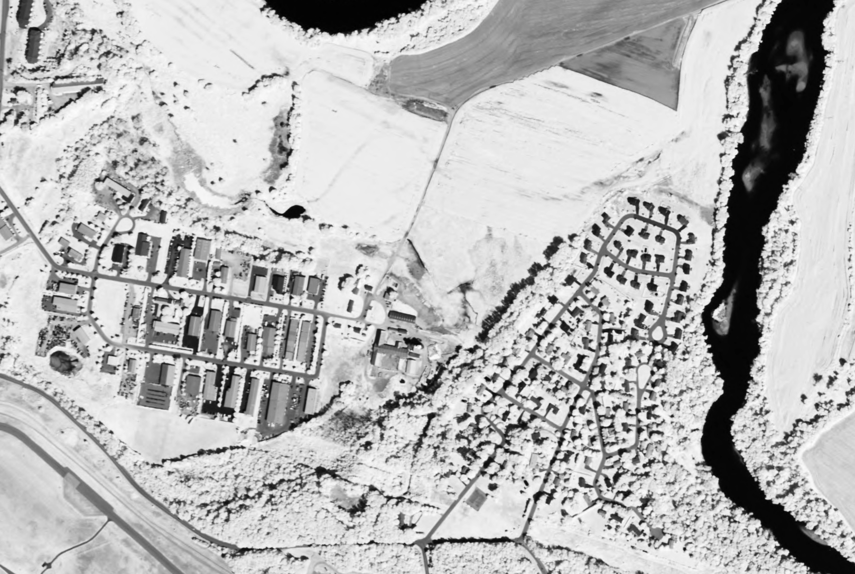

Slide 20
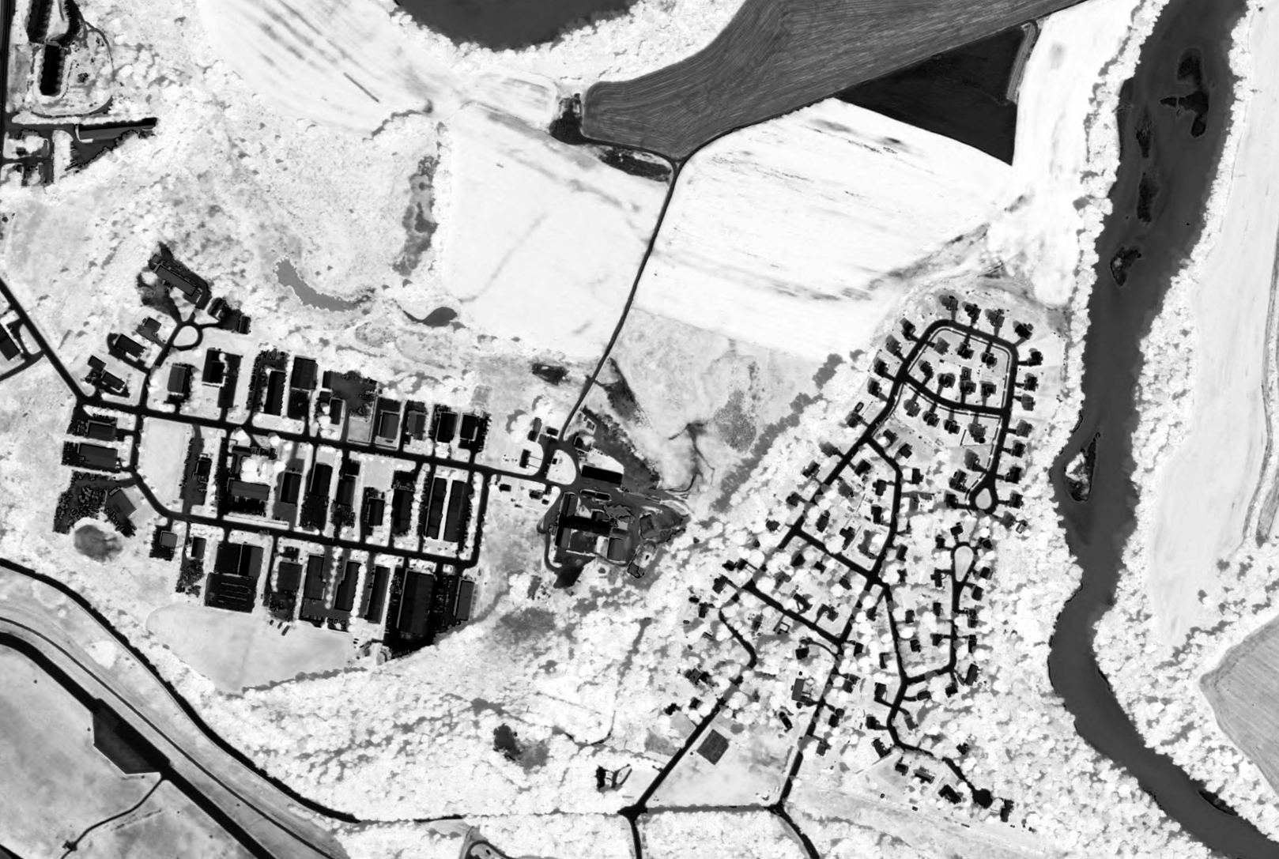
Normalized Difference Vegetation Index
(NDVI ) = (NIR - Red) / (NIR+Red)

Slide 21
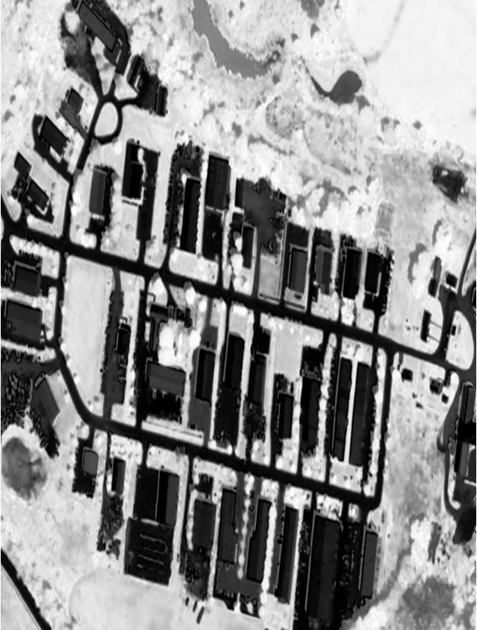
NDVI = 0.37
NDVI = -0.27

Slide 22
bright
dark

Slide 23
contrast

Slide 24
border (neighbor)

Slide 25
Shape

Slide 26
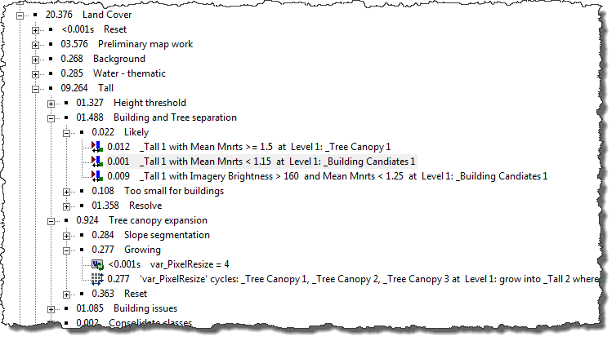

Slide 27
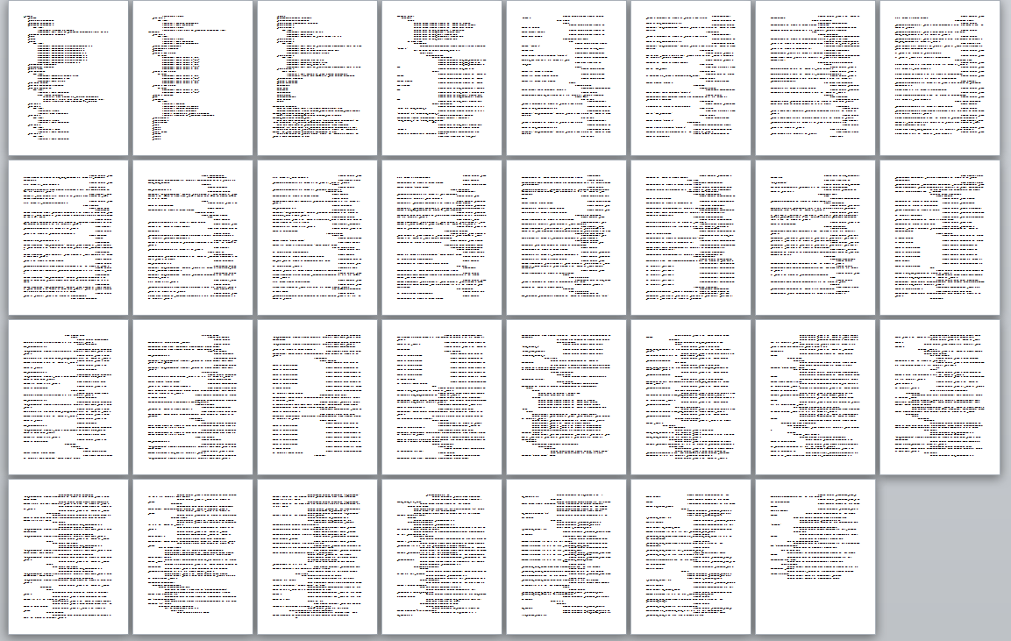
Notes:
31 pages of code
393 Algorithms

Slide 28
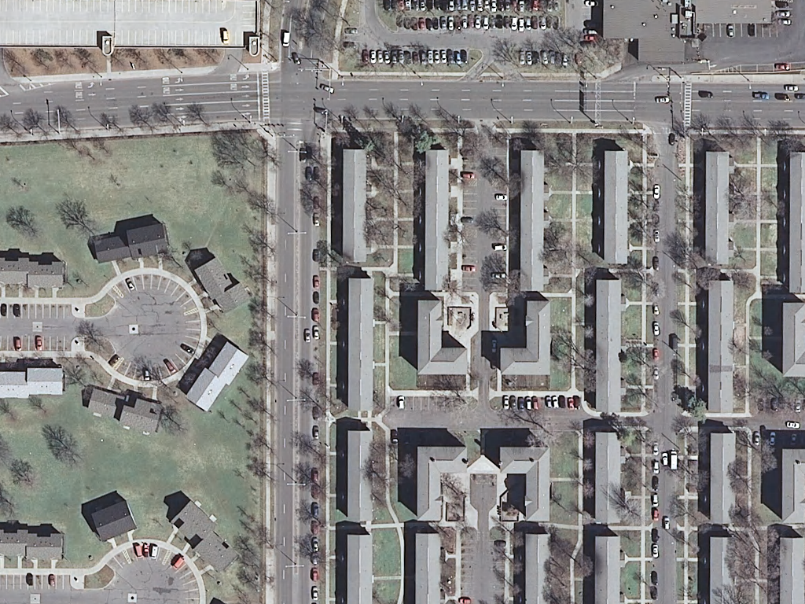

Slide 29
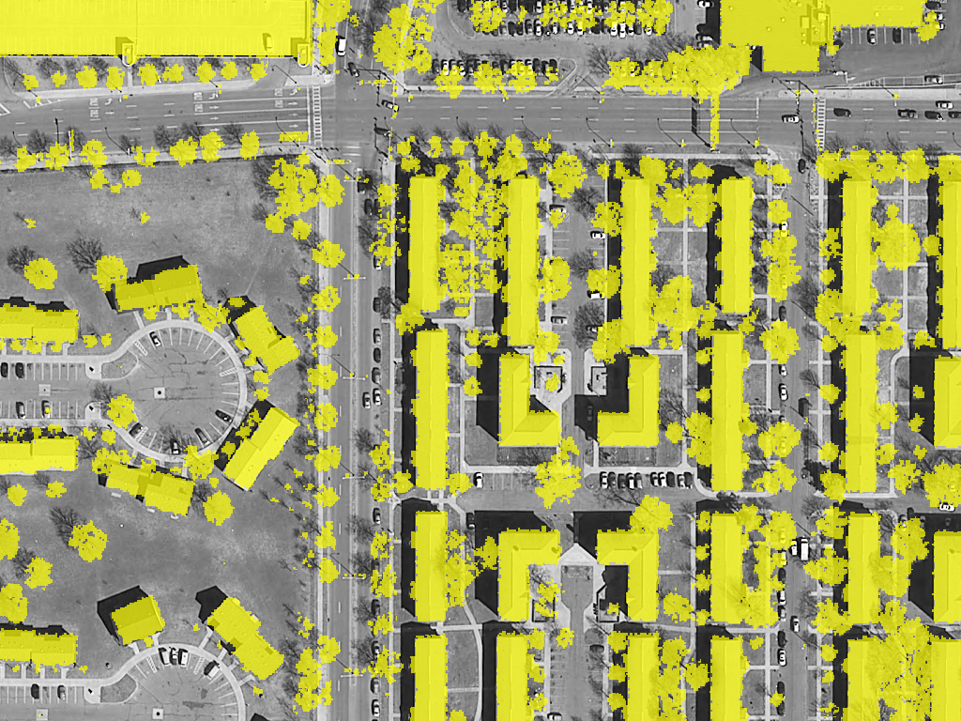

Slide 30
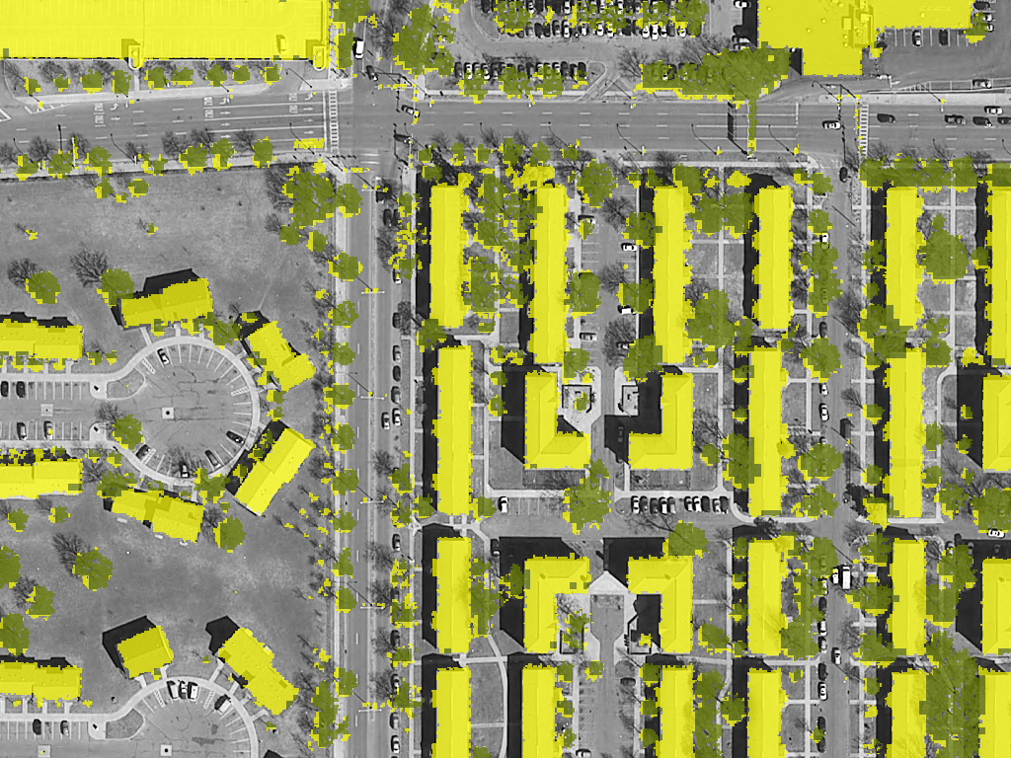

Slide 31
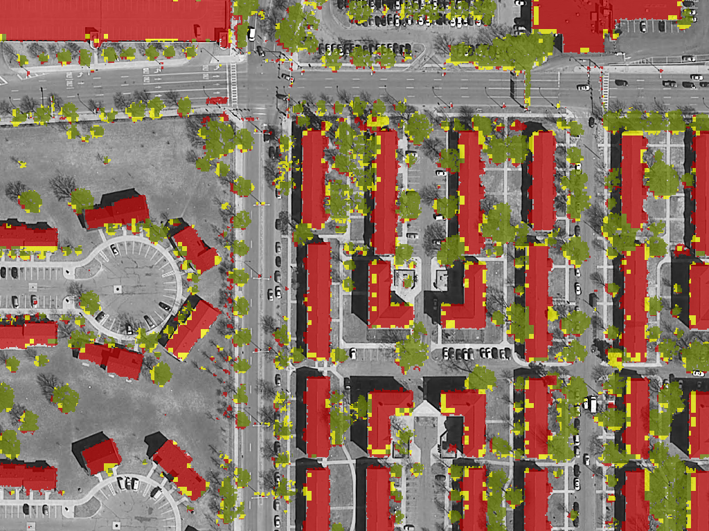

Slide 32
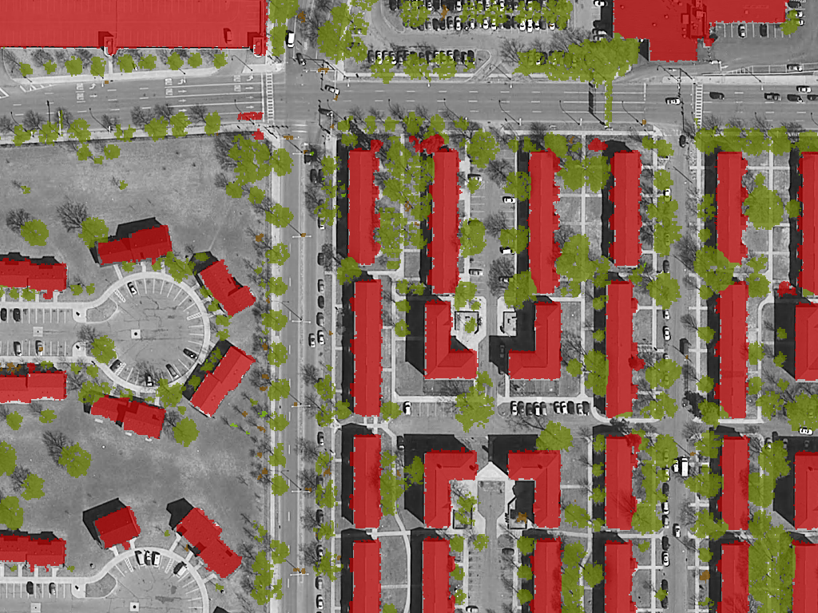

Slide 33
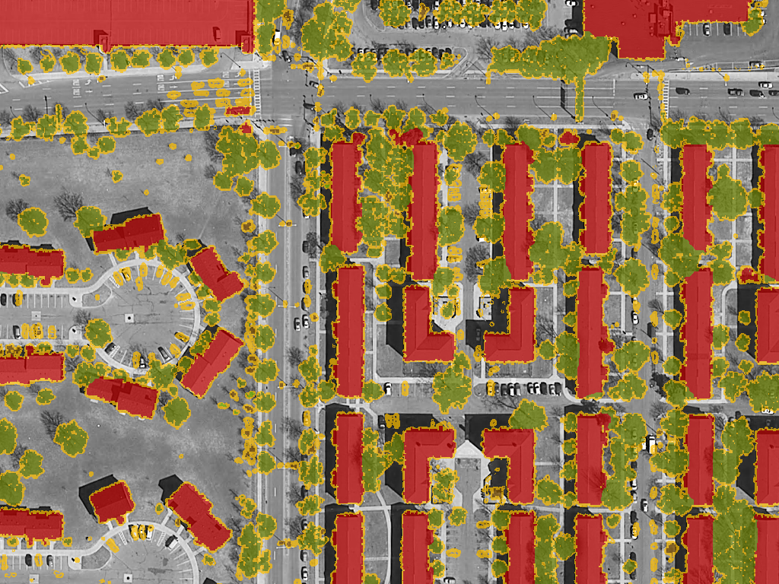

Slide 34
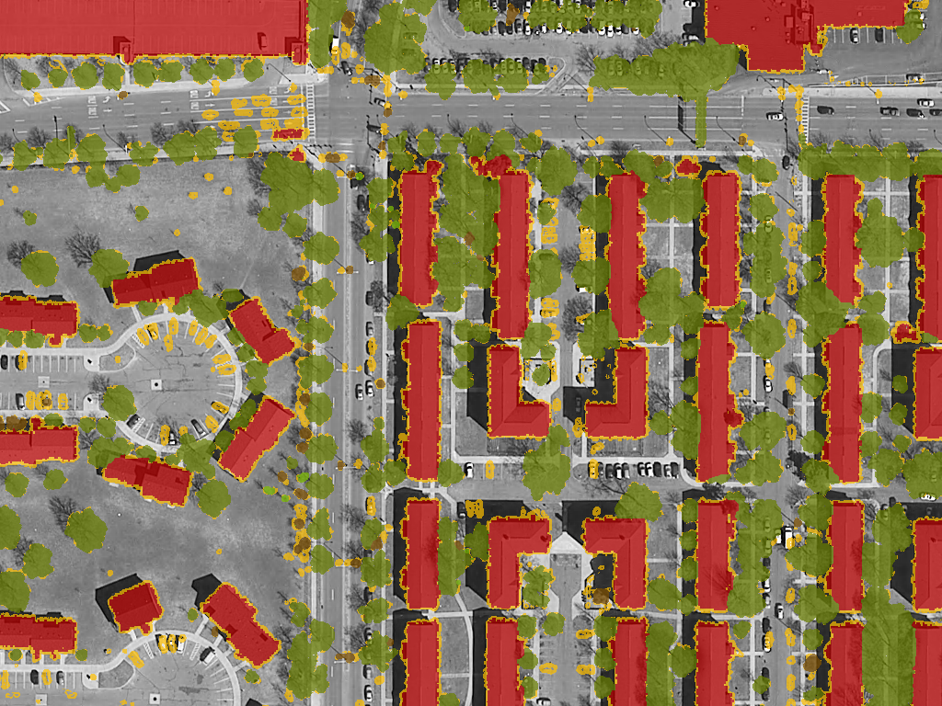

Slide 35
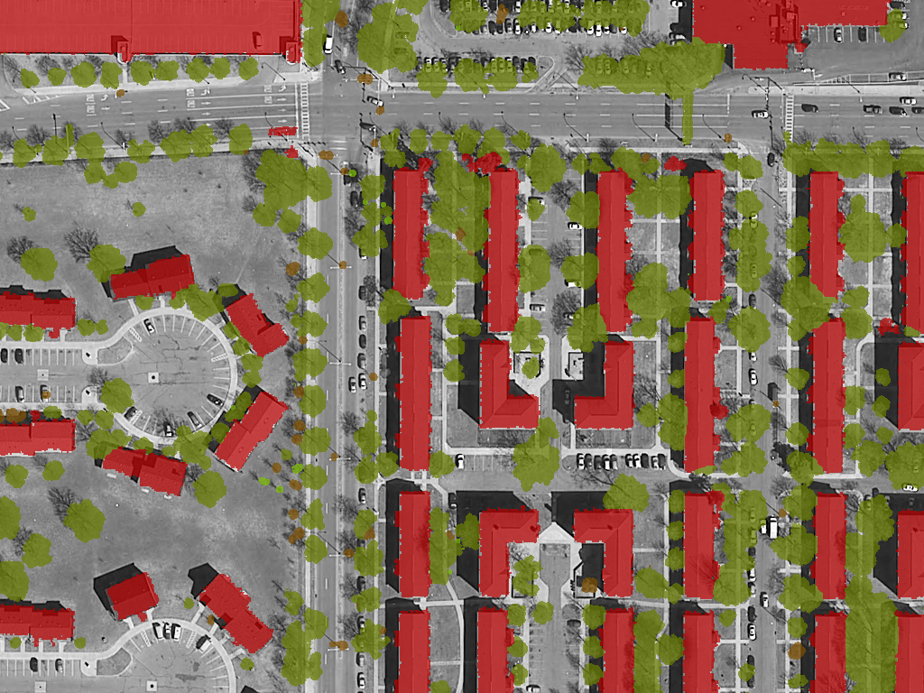

Slide 36
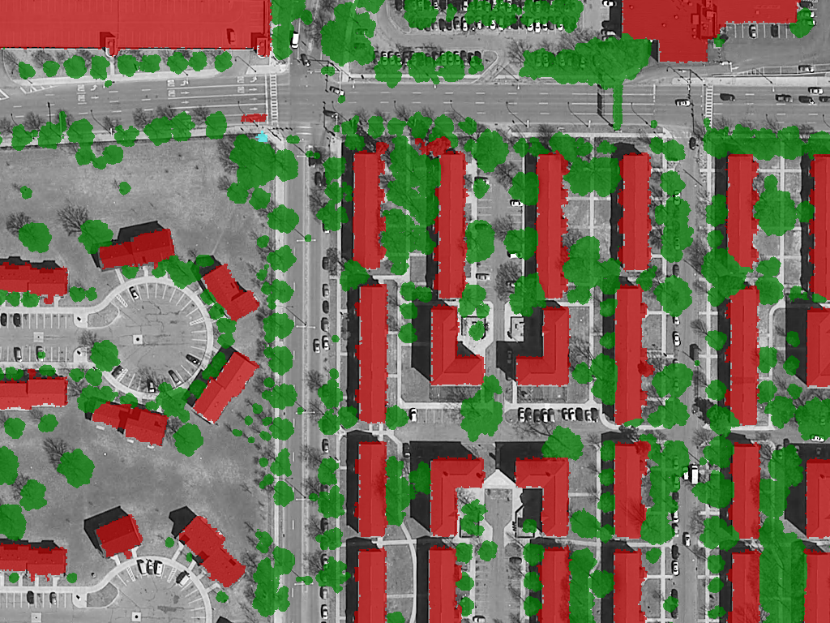

Slide 37
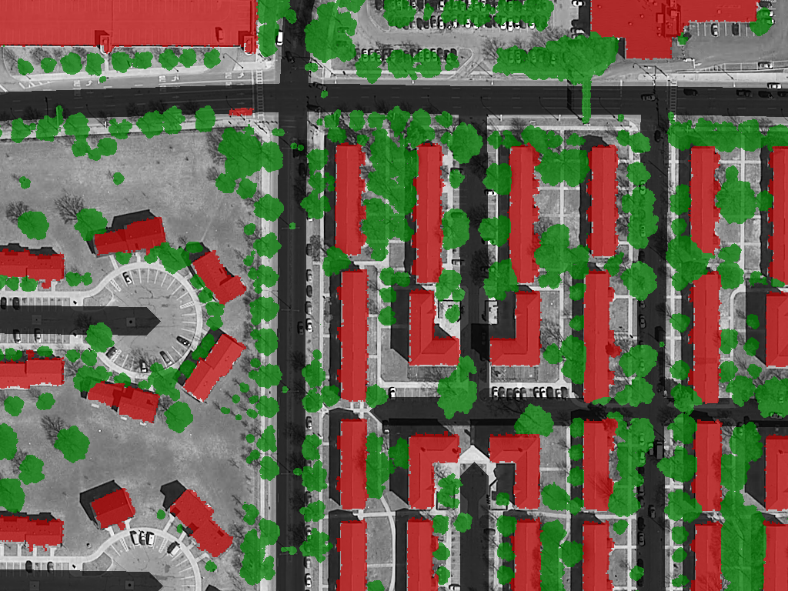

Slide 38
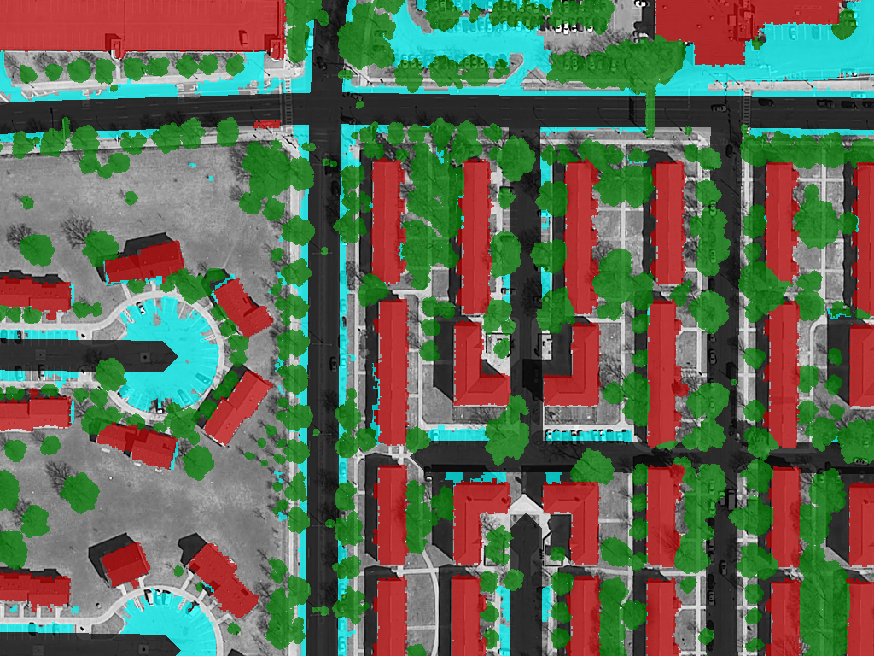

Slide 39
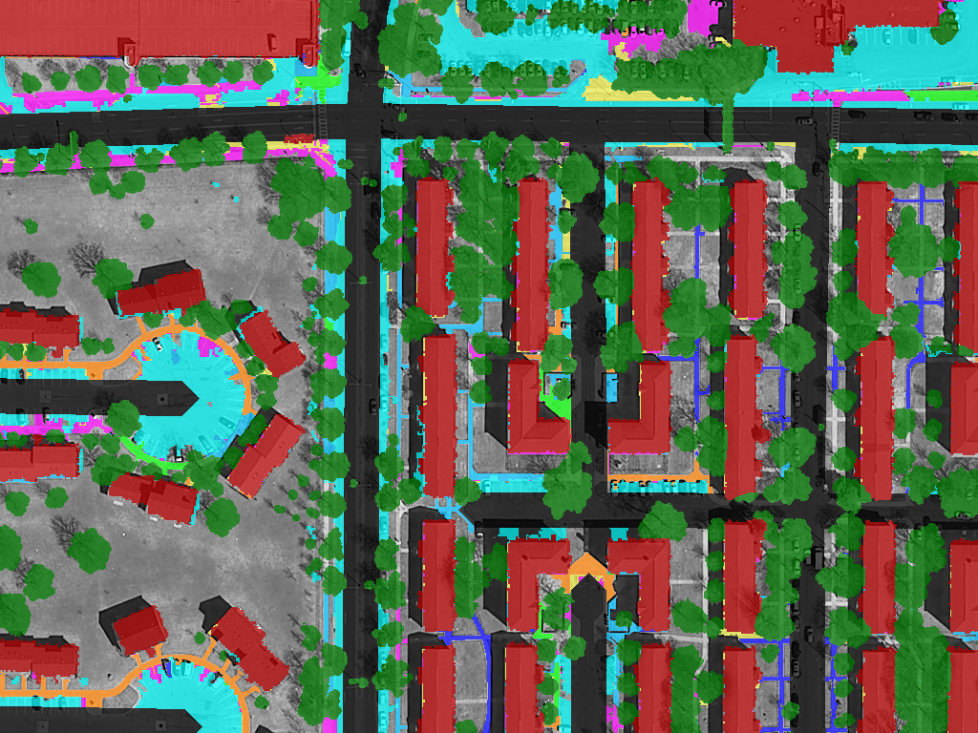

Slide 40
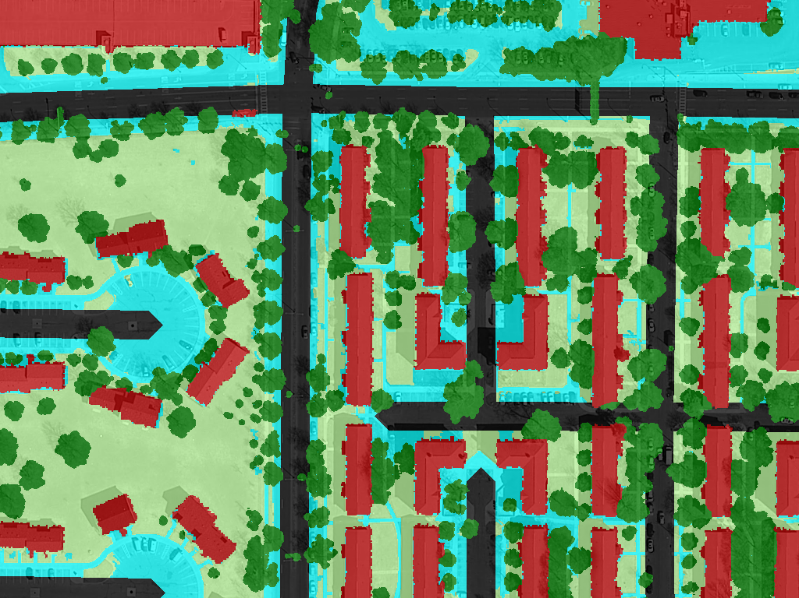

Slide 41
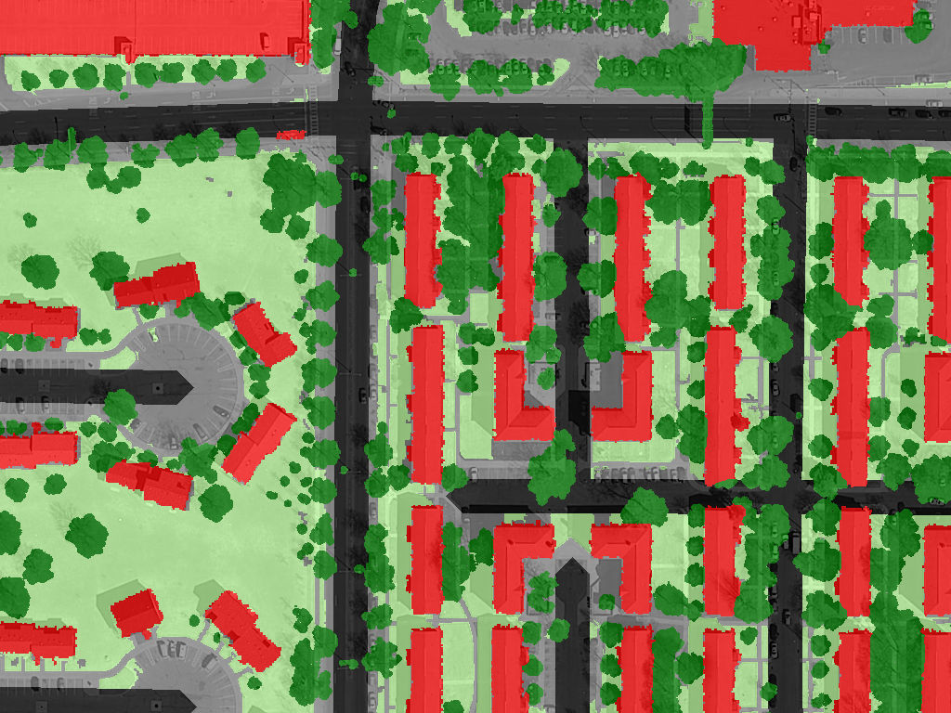

Slide 42
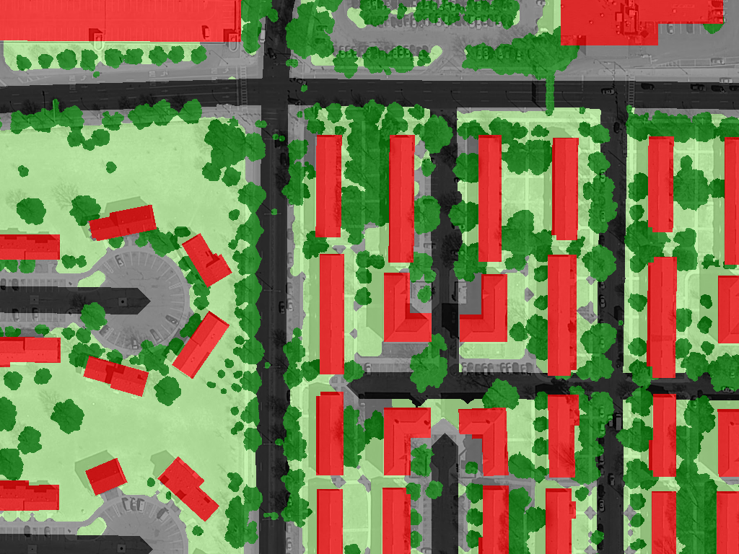

Slide 43
Limitations
Learning Curve
Small areas not cost effective
Data Limitations
Accuracy Assessment
Software Costs

Slide 44
Questions?
Keith Pelletier
pelle155@umn.edu

